Slide 1




PLC Programing
Akbar Q – Mechatronics Engineering Y1

Slide 2
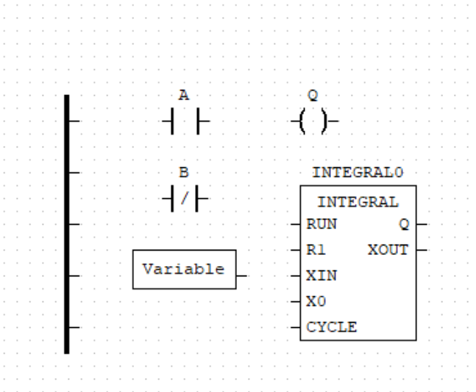
components
Power Rails
Switches (Inputs)
Coils (Outputs)
Variables
Function Blocks
20XX
Presentation title

Slide 3
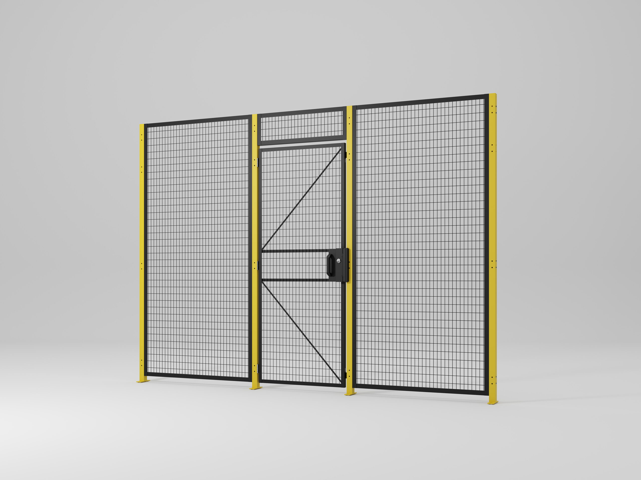
Exercise 1 – AND Gate (Safety Door & Start Button)
A machine should only start if both the safety door is closed (Sensor A) AND the operator presses the start button (B).
20XX
Presentation title

Slide 4

| ───┤A├───────────┤B├───────( Y0 ) ─|
20XX

Slide 5
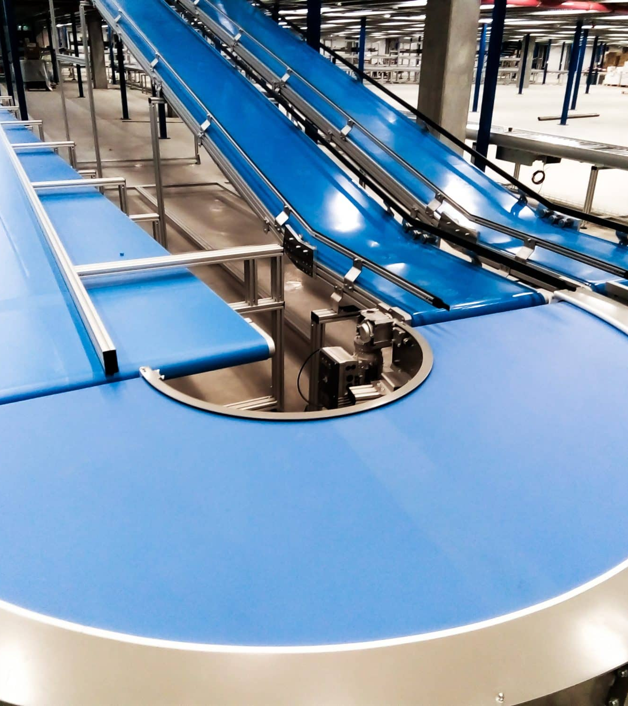
Exercise 2 – OR Gate (Two Emergency Stop Buttons)
A conveyor belt stops if either Emergency Stop Button 1 (A) OR Emergency Stop Button 2 (B) is pressed.
20XX
Presentation title

Slide 6

20XX

Slide 7

Exercise 3 – NOT Gate (Warning Light When No Material Detected)
A warning light (Y0) should turn on when no material is detected on the sensor (A).
20XX
Presentation title

Slide 8

|────┤/A├───────( Y0 ) ──|
20XX

Slide 9
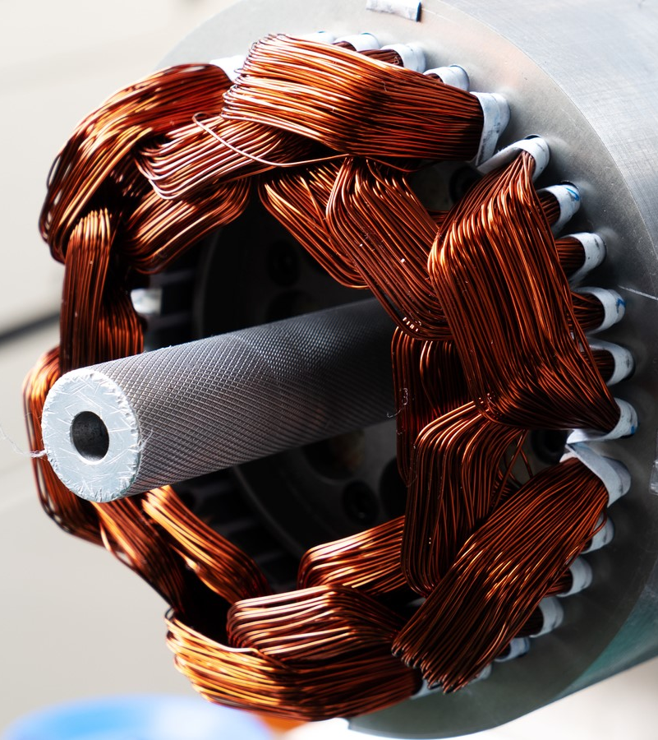
Exercise 4 – On/Off Latch (Motor Start/Stop with Memory)
A motor (Y0) must stay on after pressing Start (X0) until Stop (X1) is pressed.
20XX
Presentation title

Slide 10

X0 ────┤ ├───────( Y0 )
Y0 ────┤ ├───────( Y0 )
X1 ────┤/├───────( Y0 )
20XX

Slide 11

Exercise 5 – Blinky (Warning Beacon for Fault Condition)
A fault is detected (X0), and a beacon light (Y0) must blink every 1 second to alert operators.
20XX
Presentation title

Slide 12

X0 ────┤ ├───────[TON T0 1s]───( Y0 )
T0 ────┤ ├───────[TON T1 1s]───( Y0 )
20XX

Slide 13


Main Robot Programming
20XX
Presentation title

